Slide 1
Who earns what in urban Punjab?
How annual earnings are spread out, and how they change with age
3,768
Rs 240,000
6.88x
earners aged 15-64
median yearly earnings
top 10% vs bottom 10%
Maryam Akram | FA24-BEDS-089 | Variant 1: Punjab urban (89 = 11 x 8 + 1)
ECO346 Data Visualization Techniques | Section A | Weighted by household weight
Notes:
Variant 1 = Punjab urban. Sample: earners 15-64, earnings above zero, weighted by hhweight.

Slide 2
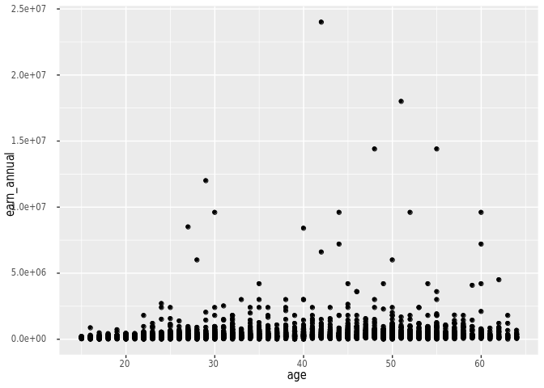
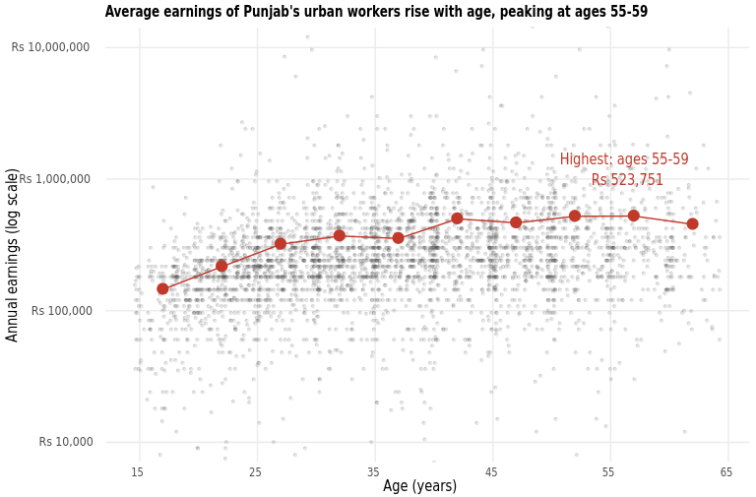
Makeover: from R's default to a readable story
R's default: nothing changed
Redesign: log scale + band means
Log scale
Jitter + transparency
Band-mean line
Notes:
Default hides most points near the bottom because of a few huge earners. Log scale, jitter and alpha fix overplotting; band means show the trend.

Slide 3
Pay rises with age and flattens in the 50s
Rs 320,776
ages 25-29
Rs 465,073
ages 45-49
Rs 523,751
ages 55-59: highest
50-54 (Rs 521,949) is almost the same as 55-59, so the peak is flat.
Notes:
Band means weighted by hhweight. No band has fewer than 30 earners.

Slide 4
What this figure cannot tell us
Not one person's career
1
It compares different people at one moment in time. It cannot show how any one person's pay grows.
The median sits on a spike
2
Many people report exactly Rs 240,000 (Rs 20,000 a month), so weighted and unweighted medians match.
Some earners are cut off
3
25 earners outside Rs 10,000 to Rs 10,000,000 are left out of the histogram.

